Slide 1
MSW Hybrid Program, CSU Stanislaus Integrative Clinical Practice Specialization for Health, Mental Health, and Behavioral Health Settings
Information Sessions Fall 2022

Slide 2
History of the Program
1st Cohort in 1993-94
1st Graduating Class 1996
Received Accreditation 1998
Three accreditation reaffirmations: 2001, 2009, 2018
Currently accredited through 2026
1000+ Graduates and counting!

Slide 3
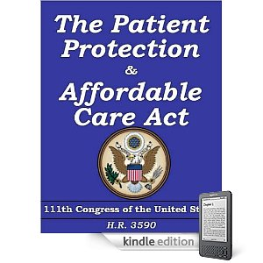
Why a Hybrid MSW Program in Integrative Clinical Practice Specialization for Health, Mental Health, and Behavioral Health Settings?
U.S. Department of Labor reported that the social services field would add 78,300 new jobs each year, an increase of 12% (2022)
Job prospects (substance abuse & mental health social workers) projected to grow at 23% between 2020-2030 to create 41,000 new openings (Bureau of Labor Statistics)
By 2028, California will have 28% fewer social workers, psychologists, and counselors than will be necessary to meet the projected demand (CA Health Care Foundation)
REALIGNMENT
Notes:
Estimates range from 23% (Hanover) , 20% (OSHPD) for medical/health.
Hanover says 16% for MH/substance abuse but OSHPD says 37% mh.
OSHPD is state Dept over behavioral health & workforce development since state Dept. of MH was dissolved. Agencies “listen” to OSHPD, and OSHPD controls distribution of WET money.
Would be good to use their numbers, and these are much higher in regard to MH.

Slide 4
The Master of Social Work Program at California State University, Stanislaus prepares social workers to advance social justice. This education is committed to social change based on an analysis of social, political and economic structures and their impact. This teaching and learning environment enables faculty, students and graduates to collaborate with others to transform the conditions which contribute to privilege and oppression. Graduates are prepared to use an advanced integrative practice approach to work with individuals, families and communities to promote personal and collective liberation.

Slide 5
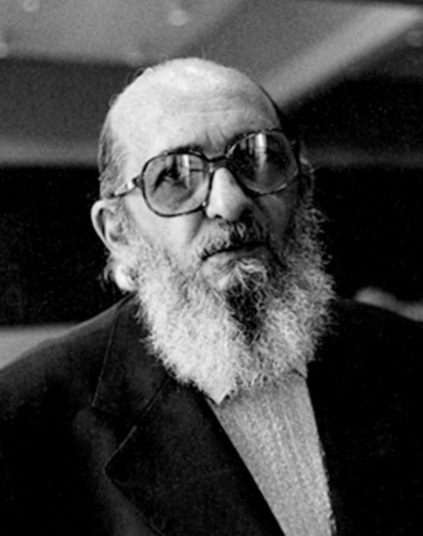
MSW Hybrid Program, CSU Stanislaus
No one educates anyone else nor do we educate ourselves, we educate one another in communion in the context of living in this world.
~ Paulo Freire

Slide 6
Program Overview: 60 units, 24 months
ACCELERATED SCHEDULE
2 courses every 8 weeks
2 face-to-face class sessions per course, including field (one Saturday per month) @ CSU Stan Stockton Campus
Remainder of course work completed online (asynchronous & synchronous)
Direct social work practice courses are included in every 8-week academic session

Slide 7
Summer Block Placement: Summer 2024 & 2025
Focus is on on practicing and integrating skills learned in coursework
40 hours per week, 13 weeks (500 hours per summer for 2 summers)
Includes:
One-to-one supervision from MSW Field Instructor
2 hours weekly seminar in a local community
2 all day Saturday Integrative seminars- Stockton Center

Slide 8
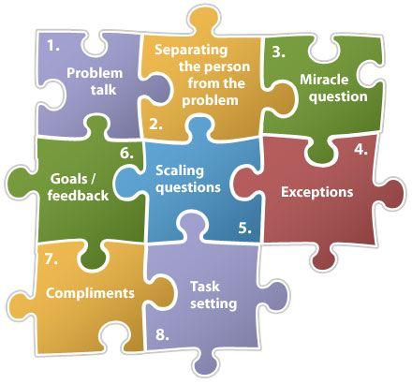
Curricular Focus
Competency based social work practice degree
Socially just clinical practice models (SFBT, CBT, Narrative)
Integrative practice approach (change factors, practice approaches)
Clinical specialization courses
Assessments (Psychosocial assessments, DSM)
Integrated Behavioral Health (resilience/wellness model)
Addictions (AOD/addictions diagnosis treatment)
Trauma treatment models (PTSD, child abuse, community, military, migration, DV)
Notes:
CA Mental Health competencies

Slide 9
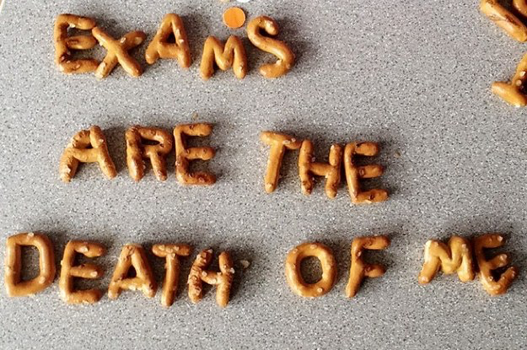
Comprehensive Exam
Focuses on HBSE, Practice, Research & Policy for clinical practice
Builds critical thinking & knowledge review for future licensing

Slide 10
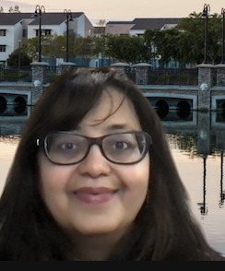
MSW Program Faculty
Sevaughn Banks, Ph.D.
Yvonne Berenguer, MSW
Pollie Bith-Melander, Ph.D.
Katie Galvin, Ph.D.
Shradha Tibrewal, Ph.D.
∙ MSW Hybrid Program Coordinator
Paul Wright, Ed.D.
Sara Cadalig, DSW,
LCSW
May Ying Ly, Ph.D.
Jenell Thompson, M.Ed., LCSW, PPSC
Valerie Leyva, Ph.D., LCSW
Kirsten Jasek-Rysdahl, MA, MSW
Dawn Costa, LCSW
Kilolo Brodie, Ph.D.
John Garcia, Ph.D.
∙ MSW Program Chair
Nancy Zamora, LCSW, PPSC
Field Director
Jane Rousseau, Ph.D.

Slide 11
Technological Needs and Support
You will need:
A computer and reliable internet connection that will support streaming video & video conferencing.
Enabled webcam and microphone
Headset microphone preferred
The University provides:
Help desk for general trouble shooting and support

Slide 12
Application Process and Timeline
University Application
MSW Program Application
Online via https://www2.calstate.edu/apply
Requirements include:
A bachelor’s degree from an accredited college or university.
A grade point average of 2.5 or better in the last 60 units is required.
Online via https://www2.calstate.edu/apply
Requirements include:
Liberal arts background
Voluntary and/or paid experience in human services
Computer literacy and reliable internet connection
Note: When completing the application in CalStateApply, you will be applying to both the University and the MSW Program

Slide 13
Autobiographical Statement, Resume and References
Autobiographical Statement
Resume
This autobiographical statement should reflect your experience in light of the MSW Program mission statement, should be typewritten (1200‐1500 words), and should enable the Admissions Committee to know something of you as a person, your writing ability, your understanding of social work, and your own life experiences.
The resume should outline your voluntary and/or paid experience in human services.
References
Three academic and/or professional references from individuals who can address qualifications for graduate study in social work, academic readiness, and work performance and proficiency is required. All recommendations must be submitted to CalStateApply directly from your recommender.

Slide 14
Application Do’s and Don’ts
Do’s
Don’ts
Do not ask your friends to be references. References should be people who have supervised you and/or know your academic abilities.
Do not forward documents to the department to upload on your behalf, or on your recommender’s behalf. We are unable to upload documents to your application.
Do not wait until the last minute to submit your transcripts from all colleges and/or universities attended.
Start your application early.
Talk to your references early. We, the department, and you, the applicant, do not have the ability to upload documents on the recommender’s behalf.
Make sure your autobiographical statement and resume are both uploaded the right way. What you see in the review screen is exactly what the reviewer will see.
Contact the department if you have any questions on the status of your application.
Please be patient as we complete the review process ☺

Slide 15
Friendly Reminders
All application components must be submitted no later than the February 1st, 2023 deadline.
This includes:
Reference letters
Transcripts from all colleges/universities attended (except for Stanislaus State graduates who have not attended college elsewhere since graduation)
Resume and autobiographical statement
The application fee to Graduate School through the CalStateApply portal

Slide 16
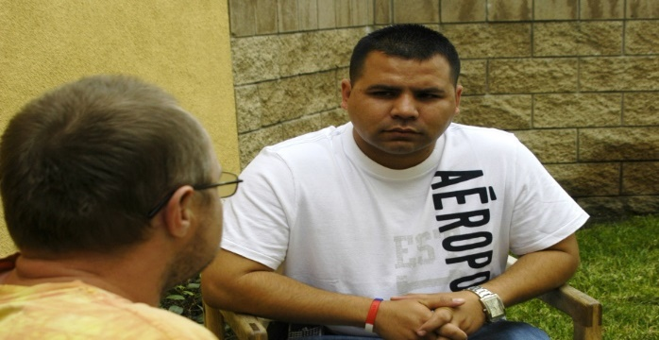
Tuition and Fees
$35,000
Financial aid may be available
unsubsidized student loans
Financial aid distributes during fall and spring semesters only. You must save your financial aid for the summer tuition payment.
Contact CSU Stan Financial Aid office
Complete FAFSA if you are considering this program
Notes:
UEE is contact for payment questions

Slide 17
Contact Information
Katrina Halstead
khalstead1@csustan.edu
mswhybrid@csustan.edu
Main Office: 209-667-3091
https://www.csustan.edu/uee/msw-hybrid

