Slide 1
Sequential Enrollment Pathway (SEP)
Merced College ADN to Stanislaus State
Modesto Junior College ADN to Stanislaus State
San Joaquin Delta College ADN to Stanislaus state

Slide 2
Sequential Enrollment
In partnership with Modesto Junior College (MJC), San Joaquin Delta College (SJDC), and Merced College, we are offering a sequential enrollment pathway that allows Nursing students to complete 4 courses that are a part of the online RN-BSN program at Stan State during their summer semesters. The courses included in the pathway are:
Summer 1: NURS3600 Transcultural Nursing (3 units)
NURS3700 Nursing Research (3 units)
Summer 2: UD-C (3 units)
UD-D (3 units)

Slide 3
Why Sequential enrollment?
The pathway will:
Not interfere with ADN program, courses are Online, 8-week Summer sessions.
reduce the student workload upon entering the Online RN-BSN program
reduce the overall cost of the Online RN-BSN program
Smooth transition into the Online RN-BSN program after completing of the ADN program and obtain CA RN license. (As long as student is eligible for admission to the Online RN-BSN program)

Slide 4
Student testimony Marlyn Diaz, cohort A sequential enrollment pathway
“My name is Marlyn, I am a first-generation college student. I was inspired to be a nurse as a child. I was hospitalized at the age of five due to an exacerbation of asthma. As a child the experience of not being able to breath and going in and out of consciousness was very frightening, but my nurses made sure I felt safe. They left a big mark in me and I want to give back.
Sequential enrollment helped me in my ADN by expanding my knowledge base. I felt that by taking the RN-BSN classes I was a more prepared student nurse. My second semester as a nursing student happened after my first summer RN-BSN classes and I was more confident in school and on the hospital floor during clinicals which allowed me to give better care to my patients.
The sequential enrollment helped me in the BSN in several ways. One way it helped is financially, I must pay less per semester since I have already taken some of the classes. In turn since I have less classes to take the workload is less. Which helps me focus better on the pending classes. This allows me to get better grades and put me in the right direction to further my education. The Sequential enrollment also help me obtain exposure to a new level of caliber classes, which means that now as I continue with my BSN I know the type of quality work the professors expect. “

Slide 5
Student testimony Anonymous, cohort A sequential enrollment pathway
“The sequential enrollment program helped me in my ADN program because the courses I took while in the program helped me in my courses. For example, the transcultural course was a very important course in my education because although the ADN program covers culture and its importance in patient care, it was nice to get a course that focused specifically on the topic. This course was extremely helpful when working with patients during clinicals.
The sequential enrollment program is so helpful for my BSN because it allows you to start the program early and not take as much classes later. For example, after graduating I got a nursing job so it was nice to be able to work and do school work because I didn’t have as much of a heavy load as all the students that were not in the sequential enrollment program. “

Slide 6
Eligibility requirements
Must be in 1st or 2nd semester of Associate's Degree in Nursing Program at time of application. Application period is March 1-31 of each year to begin in June.
Minimum overall GPA of 2.75 required
FULL GE transfer certification including Statistics
Form must be filled and signed by a college counselor
All lower division general education requirements must be completed to be eligible for SEP.

Slide 7
ADN-BSN GE Certification Form
All Lower Division A-E is required for SEP
Statistics is required
Counselor must fill out the full document and sign

Slide 8
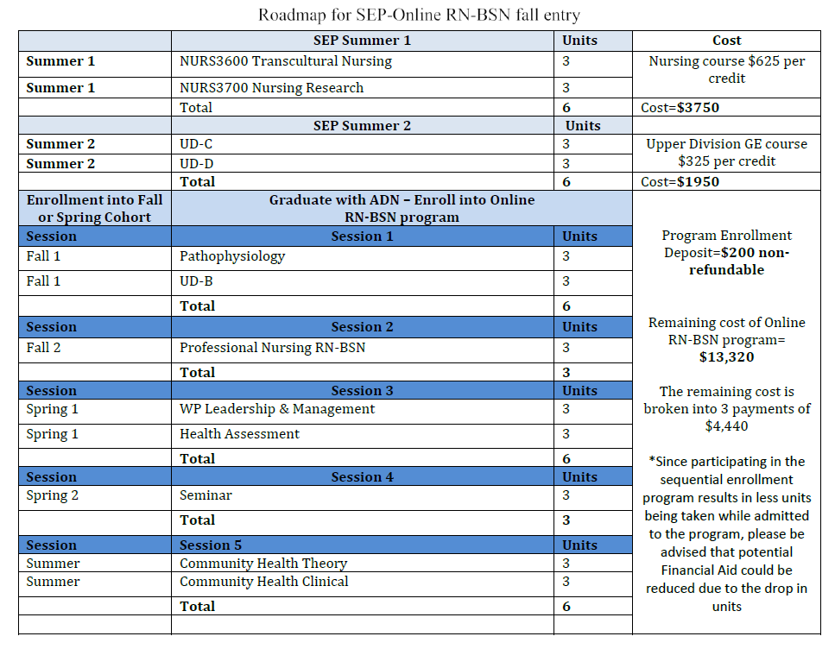
2nd semester ADN- Fall entry roadmap
Cost of courses:
Nursing cost $625 per credit
GE cost $325 per credit
Apply to the Online RN-BSN program for the following cohort after completion of your ADN program
Community Health clinical
consists of minimum 90 hours in-person clinical
Clinical is taken in the summer

Slide 9
1st semester ADN- Spring entry roadmap

Slide 10
How to Apply
Applications are submitted during the application period March 1-March 31
Follow the directions on the Sequential enrollment website ‘How to Apply’, submit your Application and GE certification filled and signed by a college counselor.
There is no fee to apply

Slide 11
Contact information
Daisy Ramirez Meza Sherry Roper
RN-BSN Navigator RN-BSN Program Director
dramirez15@csustan.edu sroper2@csustan.edu
www.csustan.edu/nursing/online-rn-bsn/sequential-enrollment

